Slide 1

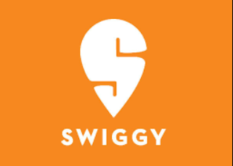
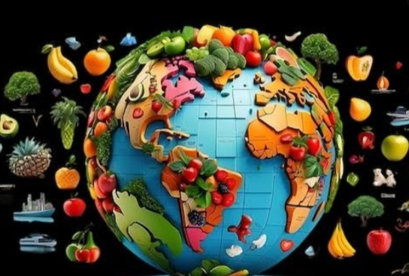



TEAM:03
CUSTOMER TREND ANALYSIS
BY FOOD BRANDS

Slide 2
TEAM MEMBERS
SAHELI BHATTACHARJEE
SUBHASHINI R
THEENUL FAREEHA M
GADDAM VIVEKA VARDHAN
UNDER THE GUIDANCE OF MENTOR
PAVITHRA KANNAN

Slide 3




3
1
PURPOSE
ANALYSED THE PURPOSE OF CREATING THE DATASET
INTRODUCTION
CUSTOMER TREND ANALYSIS HELPS FOOD BRANDS IDENTIFY CUSTOMER PREFERANCE
OVERVIEW
4
FUTURE
ENHANCEMENT
FUTURE WORKS FOR UPCOMING MILESSTONES
2
MILES STONE
ACCOMPLISHED TASKS FOR MILES STONE 1

Slide 4
INTRODUCTION
OVERVIEW
This project focuses on analyzing customer behavior and preferences toward various food brands using collected sales and feedback data. It leverages data visualization techniques to identify trends, seasonal demands, and brand performance. The goal is to support data-driven decision-making for marketing, product development, and customer engagement strategies.
OVERVIEW
This project focuses on analyzing customer behavior and preferences toward various food brands using collected sales and feedback data. It leverages data visualization techniques to identify trends, seasonal demands, and brand performance. The goal is to support data-driven decision-making for marketing, product development, and customer engagement strategies.
CORE FUNCTIONALITIES
Collect and preprocess customer sales data from multiple food brands for accurate analysis.
Build interactive dashboards using charts, graphs, and filters to explore trends by product, time, and demographics.
Enable brand-wise and category-wise comparisons to uncover top performers and under-served segments.
OUTCOME
Understanding customer preference to make changes in marketing and decision making.

Slide 5



MILESTONE 1
1
2
3
The dataset has been compiled from multiple reliable sources to ensure diversity and accuracy of insights. It integrates sales records, customer feedback, and demographic information across different food brands. This consolidated data forms the foundation for a comprehensive trend analysis and visualization.
A structured dataset was created by collecting and organizing relevant information from various sources. The data was cleaned, formatted, and standardized to ensure consistency and reliability. This curated dataset serves as the foundation for effective analysis and visualization of customer trends.
An interactive dashboard was developed to visualize key insights from the dataset in a clear and accessible format. It includes dynamic charts, filters, and drill-down features for in-depth trend analysis. The dashboard enables stakeholders to make data-driven decisions with real-time insights..

Slide 6
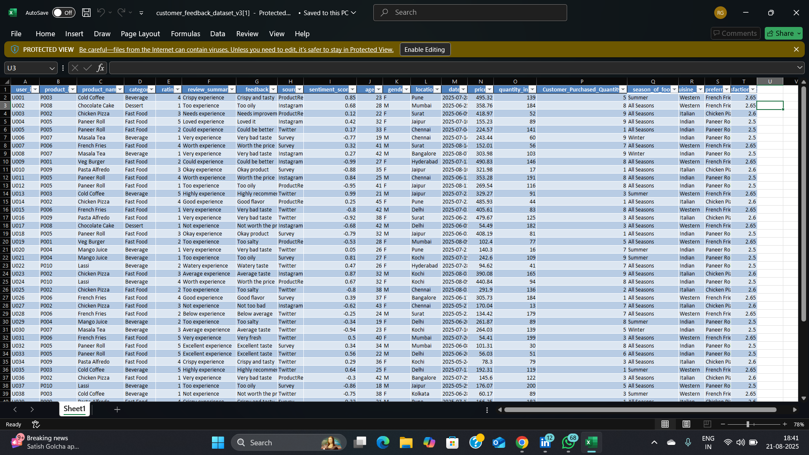
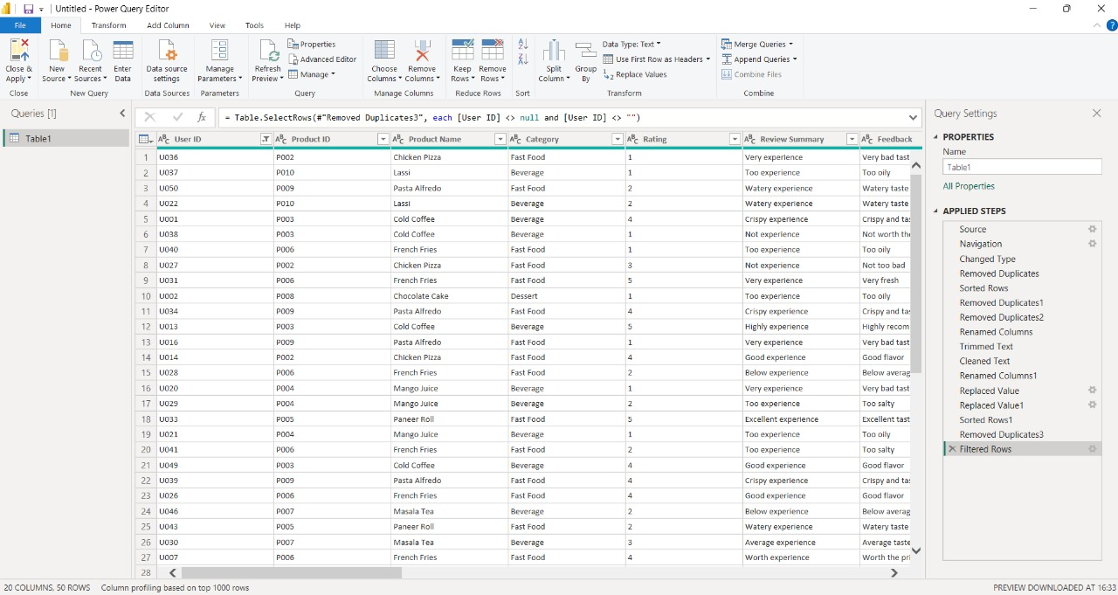
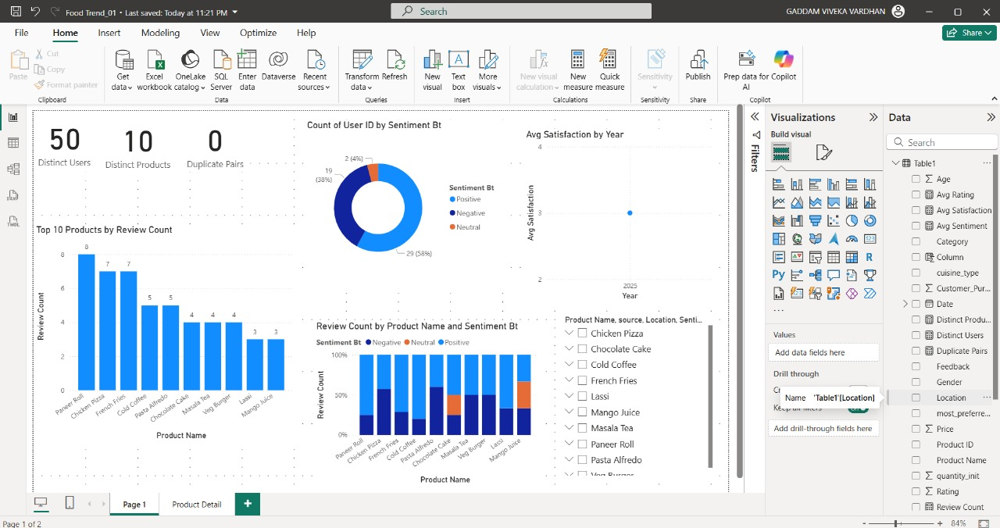
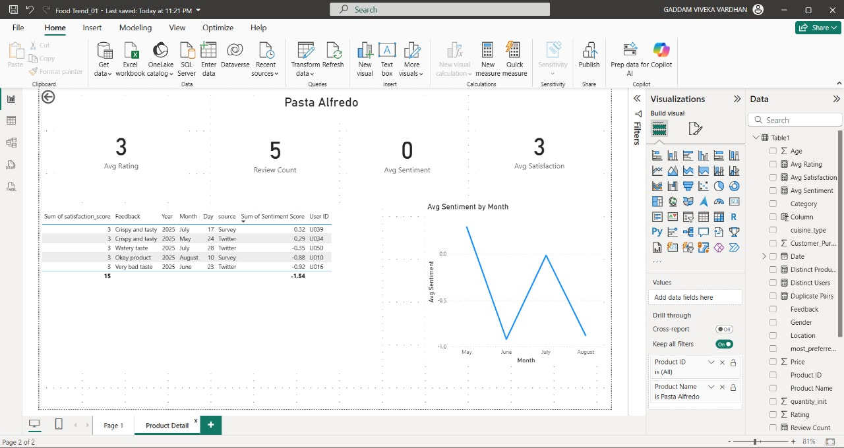
Database Created
Removed Duplicates
Dashboard created

Slide 7
PURPOSE
OF CUSTOMER ANALYSIS
IMPROVING CUSTOMER EXPERIENCE AND RETENTION
TARGETED MARKETING & PERSONALIZATION
UNDERSTANDING CUSTOMER PREFERANCE
PRODUCT INNOVATION & DEVELOPMENT
COMPETITIVE ADVANTAGE

Slide 8
UNDERSTANDING CUSTOMER PREFERANCE
PURPOSE
OF CUSTOMER ANALYSIS
PRODUCT INNOVATION & DEVELOPMENT
IMPROVING CUSTOMER EXPERIENCE AND RETENTION
TARGETED MARKETING & PERSONALIZATION
COMPETITIVE ADVANTAGE

Slide 9





FUTURE ENHANCEMENT
In the future, we plan to enhance this project by adding a segment analysis module that will allow food brands to understand customer preferences across different demographics, regions, and time frames. A dedicated product insight module will also be developed to measure product performance, identify bestsellers, and highlight items that require strategic improvement. To improve personalization, the system will integrate customer segmentation techniques, classifying customers into groups such as loyal, new, and at-risk segments for targeted engagement. We also aim to build a key-based feedback theme analysis module that will process customer reviews, categorize feedback into themes like quality, pricing, and service, and provide sentiment-based insights. In addition, we plan to introduce predictive analytics capabilities to forecast future demand trends and seasonal patterns. The dashboard will be made more interactive and customizable, enabling stakeholders to filter data and generate tailored reports. We also intend to implement real-time data integration, ensuring that insights remain current and accurate for decision-making. Overall, these future enhancements will make the system more intelligent, insightful, and impactful in driving customer-centric strategies for food brands.

Slide 10
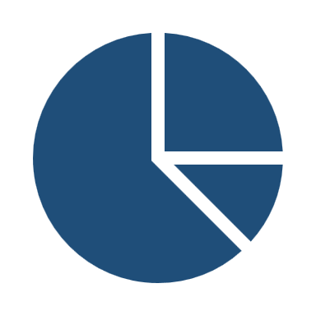



THANK YOU
Empowering decisions through data
Questions are welcome
Looking forward to your feedback!

